Slide 1
Incentive Auction MVPD Reimbursement (Form 399)
Quick Start Guide

Slide 2
Basic References
The Form 399 URL is: https://enterpriseefiling.fcc.gov/form399mvpddashboard/login.html
To log in, use your COALS ID and password. To update your information, access COALS at https://apps.fcc.gov/coals/.
To continue an existing Form 399, you can find it under the “Reimbursements” tab on the main screen.
The Catalog of Potential Expenses and Estimated Costs (Cost Catalog) can be found at https://apps.fcc.gov/edocs_public/attachmatch/DA-17-154A1.pdf.
Several other educational and reference materials can be easily accessed via the reimbursement website: http://www.fcc.gov/incentiveauctions/reimbursement
Please send questions, concerns, and issues to reimburse@fcc.gov or contact the Reimbursement Team at 202-418-2009.

Slide 3
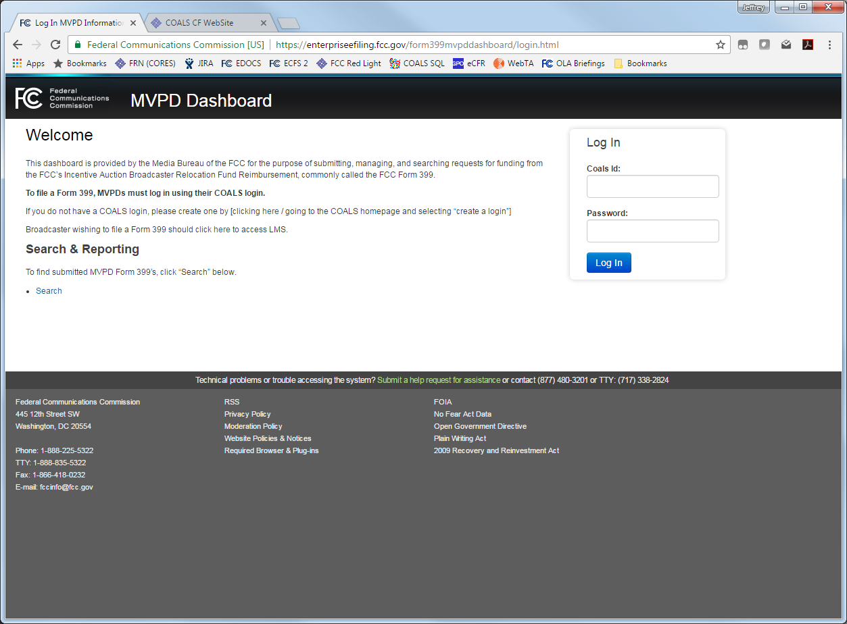
(1) MVPD Log In
Log in at: https://enterpriseefiling.fcc.gov/form399mvpddashboard/login.html
An MVPD must use the same user name and password they use to access their cable assets in COALS. A non-cable MVPD must request a special account by sending an email to reimburse@fcc.gov.
Broadcasters use a separate system to file Form 399 (https://enterpriseefiling.fcc.gov/dataentry/login.html).

Slide 4
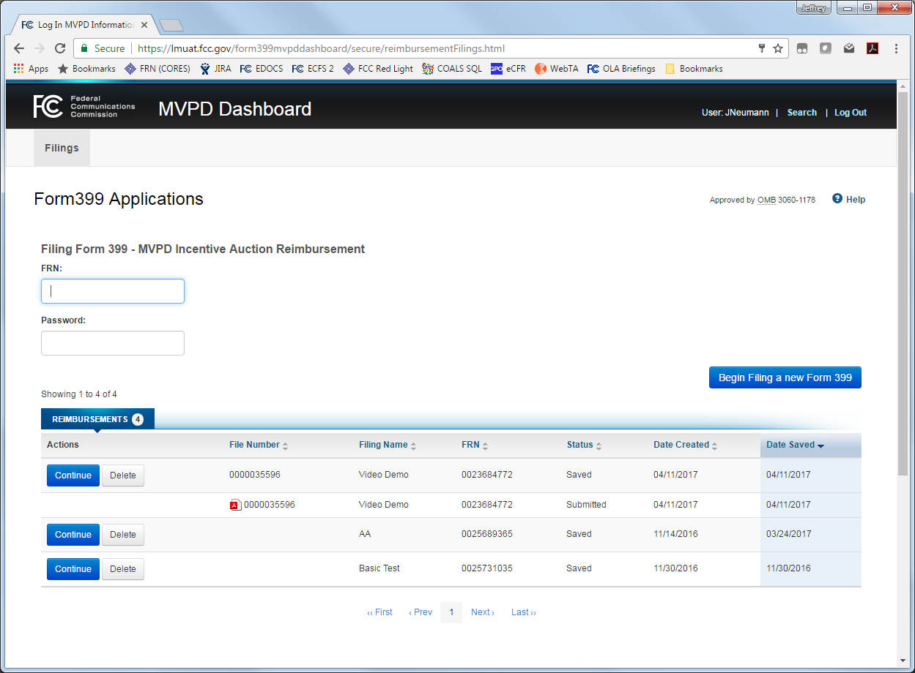
(2) Launch a New Form 399
Fill in the MVPD’s “FRN” and “Password” fields. These will be validated against CORES.
Click the “Begin Filing a new Form 399” button.
Previously saved and submitted 399s are located below. After you create a 399 for the first time, you will find it here.
The Filing Name is the first question on the form and is provided to allow the user to easily remember the nature of each filing.

Slide 5
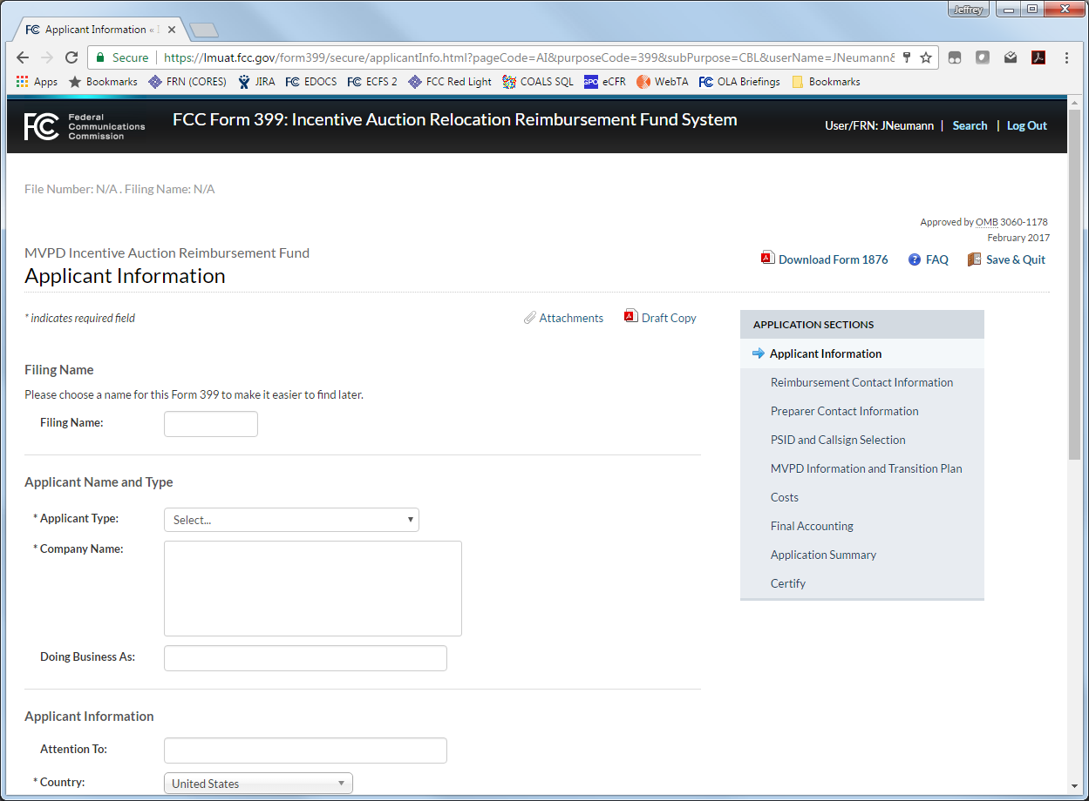
(3) Overview of the Form 399
The Form 399 uses the same template as other LMS filings. Every page consists of:
The File Number and Filing Name.
A “Save & Quit” button to exit the application without submitting.
“Attachments” and “Draft Copy” links to allow the uploading of supplementary documentation and to allow user(s) to view the current, publicly accessible version of a filing, respectively.
A Navigation Bar to quickly traverse the various sections (described on the next page).
“Back” and “Save and Continue” buttons located on the bottom of most pages.

Slide 6
(3) Overview of the Form 399 (cont.)
The Form 399 consists of four main sections – which are displayed in the navigation bar.
Applicant Information
PSID and Callsign Selection
MVPD Information and Transition Plan
The Cost Chart
Applicant Information, PSID and Callsign Selection, and the Transition Plan are designed to be completed once, though they may be revised at any time if the relevant information changes. Once these section have been completed, users can proceed straight to the cost chart to submit cost estimates and/or request reimbursement.
Complete the application information sections.

Slide 7
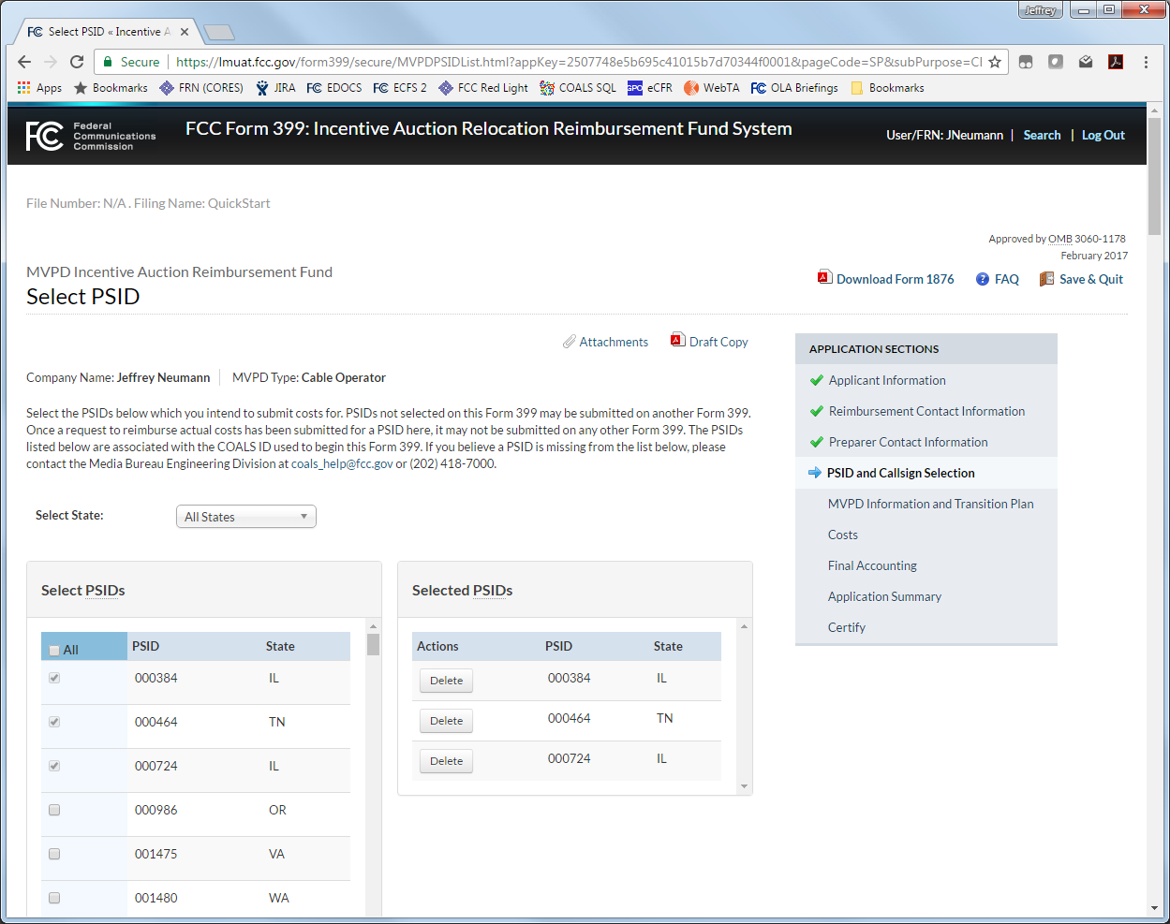
(4) PSID Selection
An MVPD which operates more than one system may temporarily group these systems onto Form 399. This is for the MVPD’s convenience and does not affect the reimbursement of costs.
PSIDs may only appear on one Form 399. After actual costs are submitted, PSIDs may only be moved to another Form 399 through the sale or transfer of a system.
All PSIDs associated with the login COALS ID are displayed on the left.
Mark the check box next to each PSID that should be included on this Form 399. They will appear in the list on the right.

Slide 8
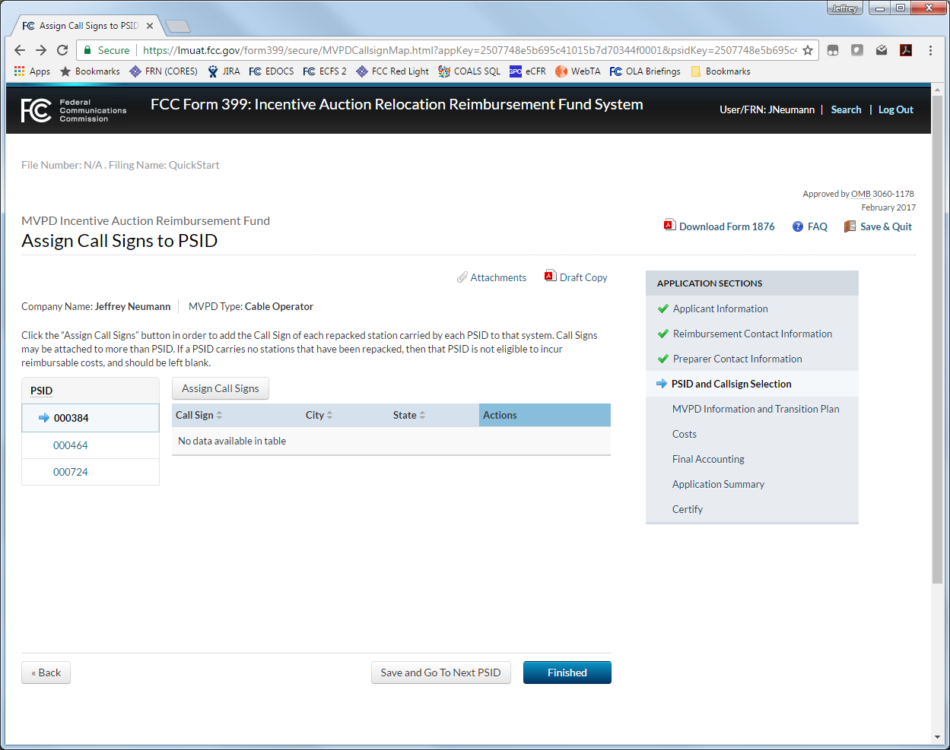
(5) Callsign Selection
For each PSID, you must indicate which repacked callsigns are carried by that system.
Select a PSID on the left.
Then click the “Assign Call Signs” button.
On the following page, select a DMA, select the carried callsigns from that DMA, then repeat for other DMAs.
Repeat this process for each PSID on the Form 399.

Slide 9
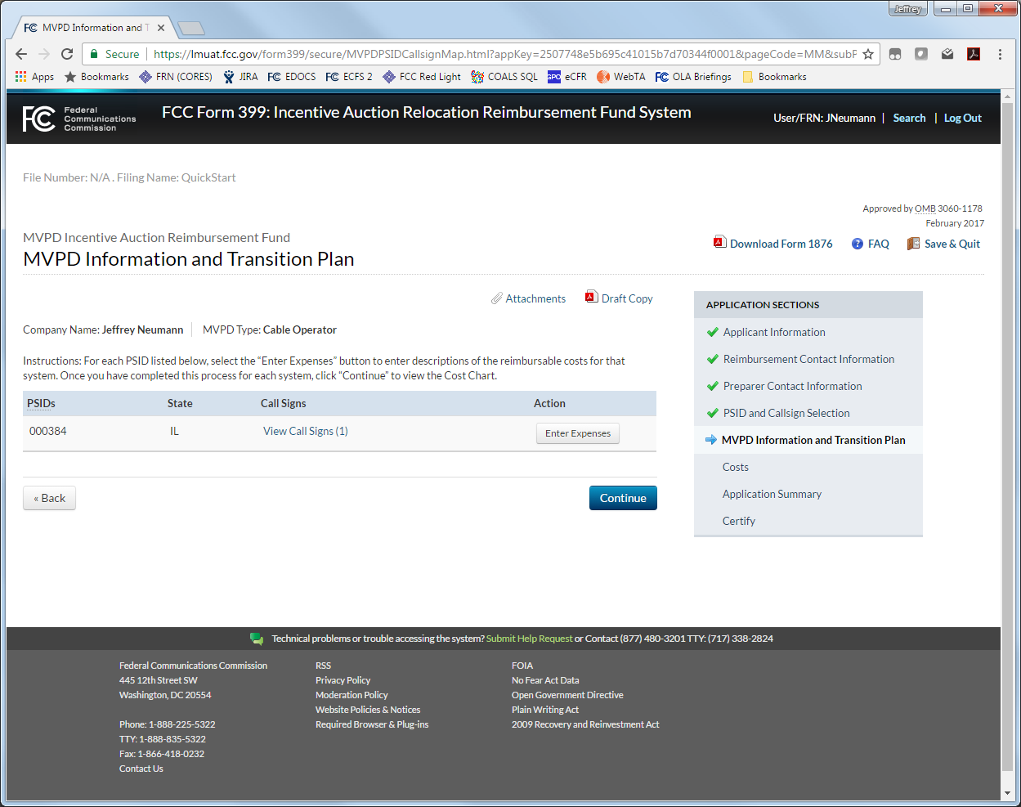
(6) Completing the Transition Plan
The Transition Plan consists of three main sections:
Channel-specific costs, which are generally RF receiver equipment, which must be purchased for a specific channel or channels;
Non-channel-specific costs, which are generally costs associated with the system; and
Additional questions relating to outside professional services and other miscellaneous expenses.
If an MVPD expects to incur a cost during the transition that is not explicitly described in one of the above sections, each section allows the broadcaster to request reimbursement for “Other Costs Not Listed.”
For each PSID on the Form 399, click the “Enter Expenses” button to fill out these three sections.

Slide 10
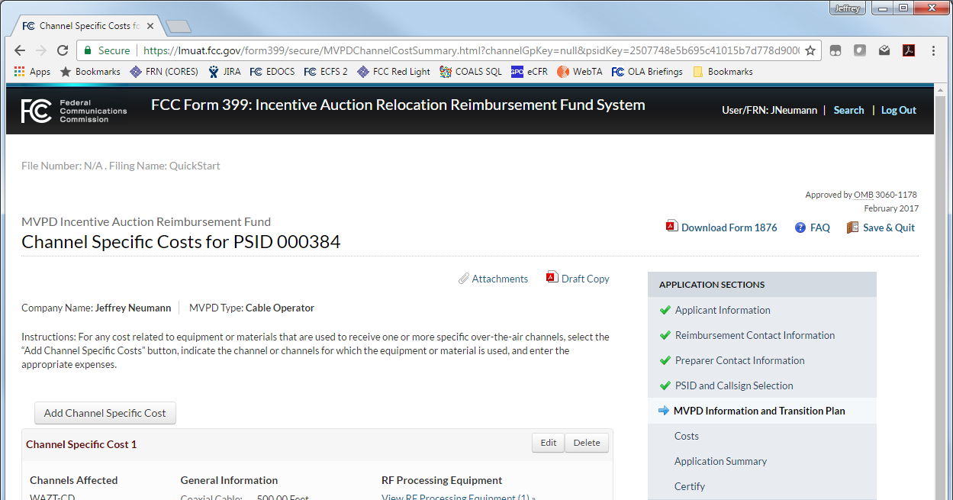
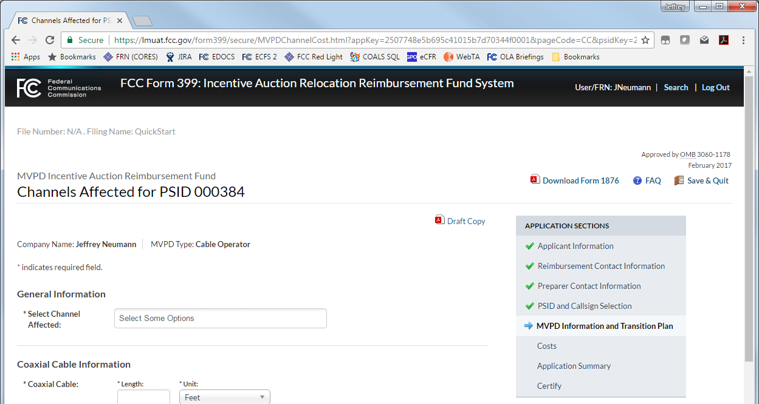
(7) Adding Channel-Specific Costs
For each PSID, you may enter Channel-Specific costs.
Click the “Add Channel Specific Cost” button.
Select the channels from the drop down list to indicate which transitioning broadcast stations require the system to incur these costs.
Fill in the relevant costs from the list
If a cost is not listed, click Save & Continue. You may add “Other” costs on the next page.

Slide 11
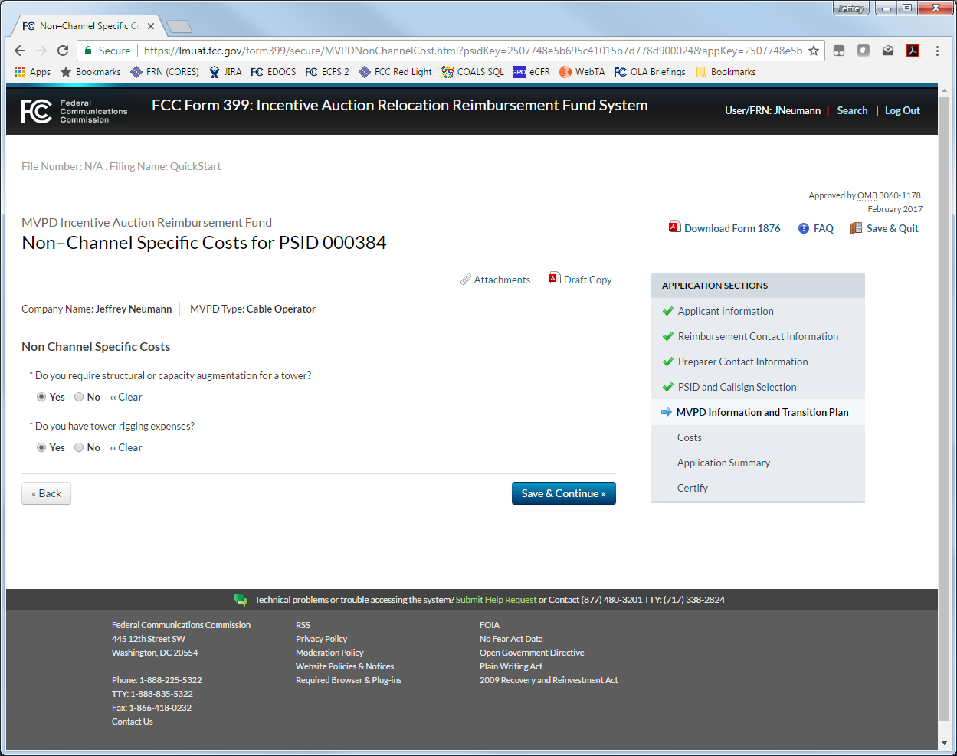
(8) Completing the Rest of the Transition Plan
After you have entered all the channel-specific costs, you will be prompted to add non-channel specific costs for the system. These include:
Technical costs (e.g., tower augmentation);
Outside professional services costs; and
Any other expenses not previously entered.
When you complete these sections, you will return the PSID list, where you can select the next PSID and repeat this process.

Slide 12
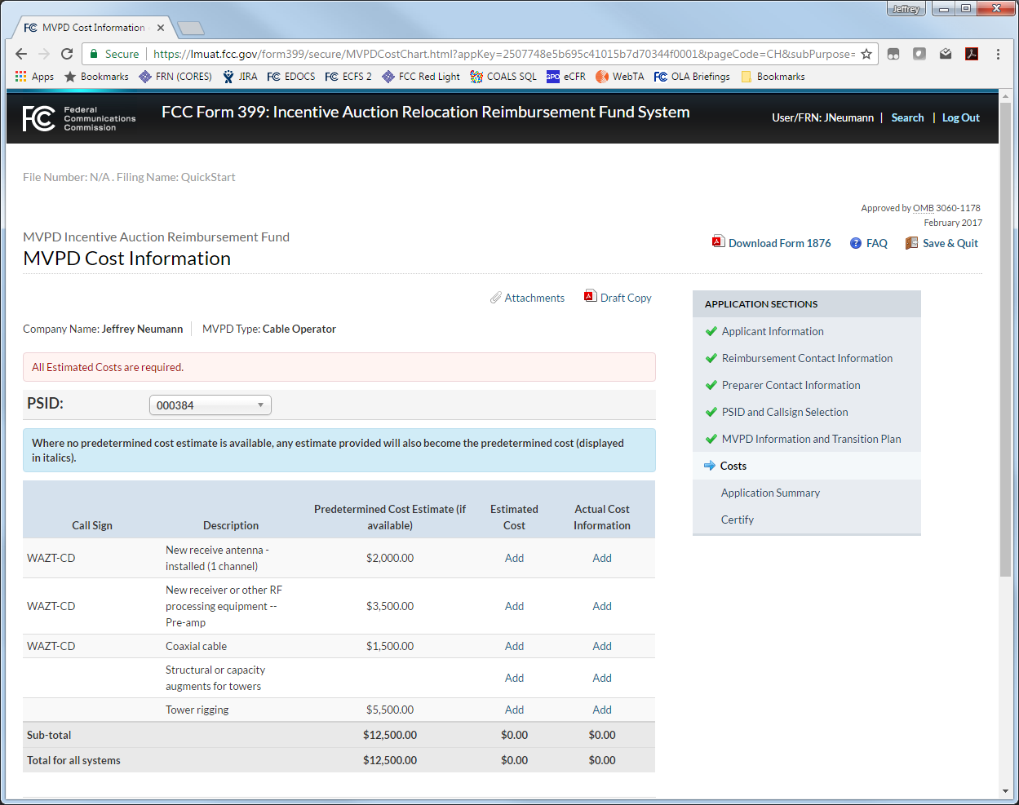
(9) Completing the Cost Chart (Estimates)
The Cost Chart consists of pages for each PSID. Each page has three columns:
The Predetermined Cost, if available, from the Catalog of Potential Expenses and Estimated Costs (Cost Catalog) at: https://apps.fcc.gov/edocs_public/attachmatch/DA-17-154A1.pdf.
The Estimated Cost as entered by user; and
The total of Actual Costs submitted for each entry (to be completed after Cost Estimate Review is completed).
When no Predetermined Cost is available, whatever is entered as an estimate will be used.
All Estimated Costs must be entered before a Form 399 may be submitted for Cost Estimate Review. Click “Add” to enter an estimated cost.

Slide 13
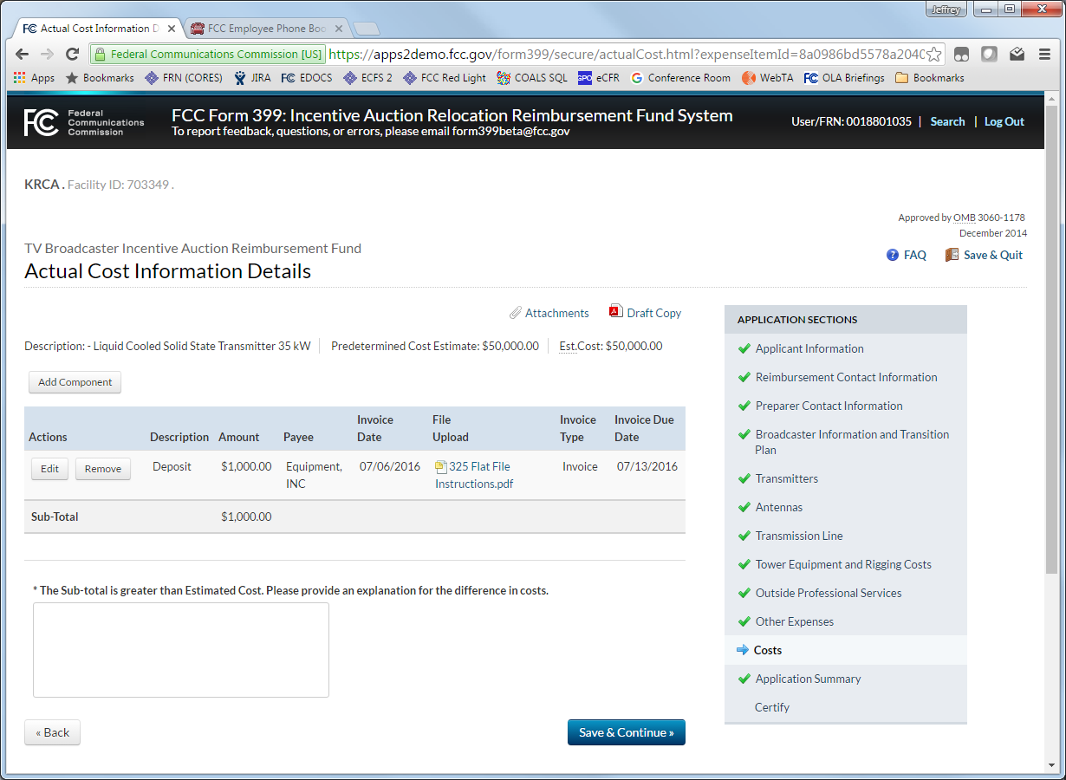
(10) Completing the Cost Chart (Actual Costs)
After clicking “Add” under the “Actual Cost” column on the previous page, the Actual Cost Information Details page is displayed.
To request reimbursement, select the “Add Component” button. Upload or select a clearly marked PDF invoice or other documentation (documentation may be used more than once), describe the invoice, and describe the cost being reimbursed.
Examples of cost components include: deposits, payments for specific parts, partial payments of invoice due, and so on.
Once all components have been added, click “Save and Continue” to return to the Cost Chart.

Slide 14
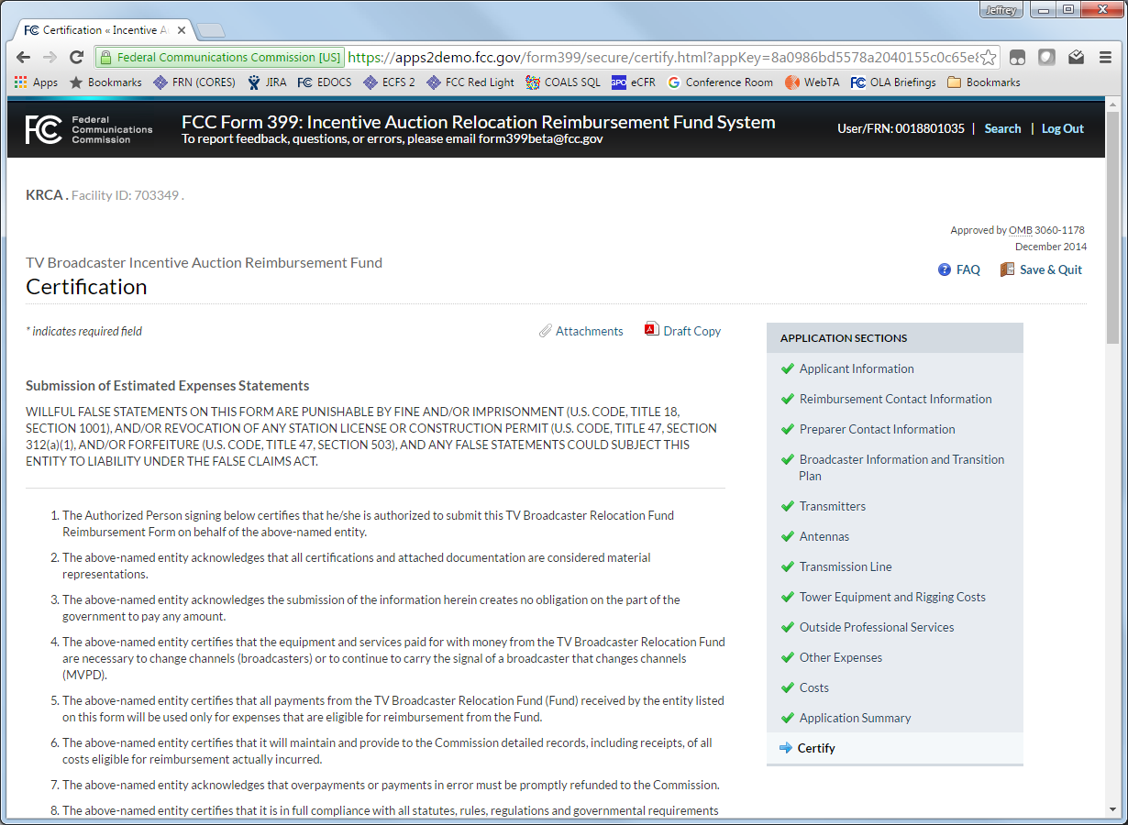
(11) Certifying and Submitting
Once you have entered all costs, continue to the Application Summary and Certification pages.
Appropriate Certification pages are displayed dynamically.
If changes have been made to estimates, then certification of estimates is required.
If changes have been made to actual costs, then a certification of actual costs is required.
At the completion of the Cost Chart, you will be asked “If Construction is Complete.” If you answer “Yes,” you will be presented the Final Accounting Certification, after which point the Form 399 will be considered complete and no longer editable.
If construction is designated complete, then a final certification is required and the application will be locked.
At the conclusion of the Reimbursement Program, answering “No” will present the Final Allocation workflow. However, prior to that point, answering “No” will merely preserve a 399 for future submissions.

Slide 15
Questions and Feedback
Please submit questions and feedback for reimburse@fcc.gov or contact the Reimbursement Team at 202-418-2009.

Slide 16
Appendix Abbreviations and Acronyms
COALS – Cable Operations and Licensing System
DMA – Designated Market Area
FRN – FCC Registration Number
LMS – Licensing and Management System
PSID – Physical System ID
RF – Radio Frequency

